Slide 1
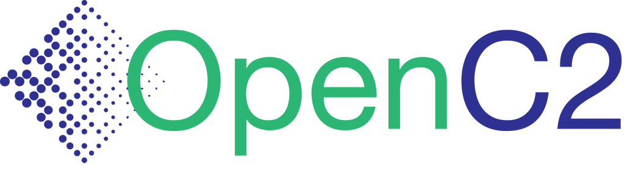
Schema Design
Sept 2016
Dave Kemp -- NSA, IA Architectures & Mission Applications

Slide 2
Schema
A schema is:
Generic: a structured framework or plan
Database: the structure of a database system, described in a formal language that defines the tables, the fields in each table, and the relationships between fields and tables
XML/JSON: a description of the elements in a document that can be used to validate each piece of content
A schema can be:
abstract or concrete
formal (written in a syntax definition language) or informal

Slide 3
Abstract Syntax*
An Abstract Syntax Language is:
A formal language for specifying the logical structure of data that is to be exchanged between two endpoints
independent of hardware platform, operating system, programming language, local representation, etc.
Standard sets of rules for encoding instances of logical data structures that are specified in abstract notation
for the purpose of transmission
* Description and Principles by Allesandro Trigila
http://www.ieee802.org/802_tutorials/2010-11/
Describes ASN.1, but applies to any abstract syntax language

Slide 4
Principles and Benefits* of abstract syntax
Separation of concerns
The description of the logical structure of a message is kept completely separate from the details of the encoding
Message descriptions are machine-processable
This enables the creation and use of software development tools and testing tools that can read and understand the formal definitions
Encodings are standardized
The problem of specifying detailed encodings and the problem of encoding/decoding messages and their fields do not need to be addressed again and again
Extensibility
It is possible to extend a message description in controlled ways while ensuring backward- and forward-compatibility between different version implementations

Slide 5

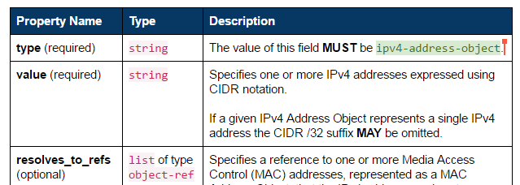
OASIS CTI Data Definitions
STIX, TAXII, CybOX are specified in Property Tables
Abstract description
Independent of serialization (XML, JSON, binary)
Informal definition of data objects
Cannot be machine parsed, validated, or translated
Interim step toward formal abstract specifications
Would enable automated translation to concrete schemas:
XSD
JSON Schema
Proto3
…

Slide 6
OpenC2 Data Definitions
Current implementation: Python abstract data structures
Executable: enables encoding- independent message validation
Defines OpenC2 abstract syntax
Unambiguous type checking
Validates example messages
Supports multiple message formats
JSON (multiple dialects)
XML
Binary
Corresponds directly to informal property tables and formal abstract syntax
class OpenC2Command(Record): vals = [ ('action', Action, ''), ('target', Target, ''), ('actuator', Actuator, '?'), ('modifiers', Modifiers, '?')]
class Action(Enumerated):
vals = [
'scan', # 1
'locate', # 2
'query', # 3
...
'remediate'] # 35
class Target(Record):
vals = [
('type', TargetTypeValue , ''),
('specifiers', cybox.CyboxObject,
'?,{type}')]

Slide 7
Abstract Syntax - Structures
JSON Data Model
Array – ordered list of items
Item has position, no name
Object – unordered set of properties
Property has name, no position
Abstract Data Model
Record – ordered list of fields
Field has both name and position
Encoded in JSON as either Array or Object
Decoder restores names to Array fields, positions to Object fields
Map – unordered set of fields
Field has name, no position
Encoded in JSON as Object
class OpenC2Command(Record): vals = [ ('action', Action, ''), ('target', Target, ''), ('actuator', Actuator, '?'), ('modifiers', Modifiers, '?')]

Slide 8
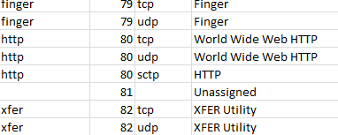
Abstract Syntax – Names
JSON Data Model
Names transmitted as strings
Field names / property keys (e.g., “type”, “value”, “Action”)
Literals in a vocabulary (e.g., “ipv4-address-object”, “TCP”, “scan”)
Abstract Data Model
Names transmitted as either strings or tags
Tags (ElementIDs) assigned to Names in a registry
Example - port numbers:
class Action(Enumerated):
vals = [
'scan', # 1
'locate', # 2
'query', # 3
...
'remediate'] # 35

Slide 9
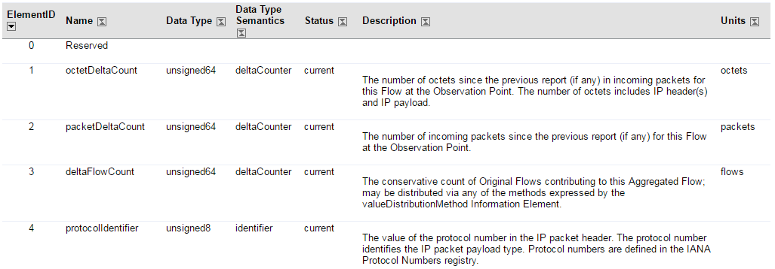
Abstract Syntax – Names (cont.)
IP Flow Information Export (IPFIX) element registry
Abstract syntax assigns IDs (1) to names (“octetDeltaCount”)
Concrete encoding uses one or the other
Decoder supplies name corresponding to received ID
Namespace used to identify registry

Slide 10
JSON Abstract Encoding Notation (JAEN)
JSON document that defines an abstract schema
Import directly by applications, or
Translate to concrete schemas used by applications
Two sections:
- config information
- datatype definitions
Definitions:
- datatype, base type, opts, desc
Fields:
- position (ordinal) or tag
- field name
- datatype
- options
- description
{
"meta": {
"module": "openc2"
},
"types": [
["OpenC2Command", "Record", [], "", [
[1, "action", "Action", [], ""],
[2, "target", "Target", [], ""],
[3, "actuator", "Actuator", ["?"], ""],
[4, "modifiers", "Modifiers", ["?"], ""]
]]
]
}

Slide 11
Abstract Schema Representations
{
"meta": {
"module": "openc2"
},
"types": [
["OpenC2Command", "Record", [],
[1, "action", "Action", [],
[2, "target", "Target", [],
[3, "actuator", "Actuator", [
[4, "modifiers", "Modifiers",
]]
]
}
JSON Load
JSON Dump
Abstract Syntax
JAEN
OpenC2Command ::= SEQUENCE {
action Action,
target Target,
actuator Actuator OPTIONAL,
modifiers Modifiers OPTIONAL
}
Tag | Prop | Type
1 | action | String
2 | target | TargetType
3 | actuator | ActuatorType
4 | modifiers | ModifiersType
OpenC2Command ::= RECORD {
action Action,
target Target,
actuator Actuator OPTIONAL,
modifiers Modifiers OPTIONAL
}
ASN.1
class OpenC2Command(Record):
ns = "openc2"
vals = [
("action", Action, ""),
("target", Target, ""),
("actuator", Actuator, "?"),
("modifiers", Modifiers, "?")]
Property Tables
JAEN Abstract Syntax
Python Classes

Slide 12
JAEN Abstract Syntax (JAS)
Similar to ASN.1, but modified for ease of use
ASN.1 has no first-class map (key:value pair) type
SEQUENCE / SEQUENCE OF and SET / SET OF are the only compound ASN.1 types
Table Constraint syntax is general but cumbersome
JAS defines MAP to represent Identifier:Typereference pairs
ASN.1 restricts case for Identifier and Typereference
JAS allows both upper and lower case first character
ASN.1 SEQUENCE does not support encoding modes
JSON Encoding Rules (to be defined) might add encoding modes
JAS defines RECORD to be encoded as either JSON object or array
JAS requires explicit tags for names
RECORD field tags are optional, must be ordinal if present
JAS does not allow anonymous type definitions
Fields contain references to named types
Supports direct translation to JAEN without compiling

Slide 13
JSON Encoding Modes
Verbose
RECORD encoded as Object
Highest bandwidth
Arguably most human-readable (explicit field names)
Concise
RECORD encoded as Array
Reduced bandwidth
Arguably more readable (no field name clutter)
Minimized
RECORD encoded as Array, Names encoded as Tags
Most bandwidth efficient, least readable
Use directly for transmission, or as visualization of binary encoding

Slide 14
Concrete Schema Generation
{
"meta": {
"module": "openc2"
},
"types": [
["OpenC2Command", "Record", [],
[1, "action", "Action", [],
[2, "target", "Target", [],
[3, "actuator", "Actuator", [
[4, "modifiers", "Modifiers",
]]
]
}
JSON Load
JSON Dump
Abstract Syntax
API (Application Programming Interface)
JAEN
JSON Schema Verbose
JSON Schema Concise
JSON Schema Minimized
XSD
Proto3 Binary
CBOR Binary
[34,[8,["cdn.badco.org"]]]
["mitigate",["cybox:Hostname",["cdn.badco.org"]]]
{"action":"mitigate","target":{"type":"cybox:Hostname","specifiers":{"Hostname_Value":"cdn.badco.org"}}}
Encoding (Message Formats)

Slide 15

Application Development
{
"meta": {
"module": "openc2"
},
"types": [
["OpenC2Command", "Record", [],
[1, "action", "Action", [],
[2, "target", "Target", [],
[3, "actuator", "Actuator", [
[4, "modifiers", "Modifiers",
]]
]
}
Tag | Prop | Type
1 | action | String
2 | target | TargetType
3 | actuator | ActuatorType
4 | modifiers | ModifiersType
OpenC2Command ::= RECORD {
action Action,
target Target,
actuator Actuator OPTIONAL,
modifiers Modifiers OPTIONAL
}
Create JAS schema based on standard specs
Translate
Property Tables
JAEN Abstract Syntax
(optional)
JAEN
Dynamic Load
Orchestrator
Producer
Consumer
Actuator
OpenC2
(deny)
JSON or Binary
API (Application Programming Interface)
Encoding (Message Formats)

Slide 16
Message Structure
API supports structure (nested objects) and template (object with path keys) formats
Identical information, lossless bidirectional conversion
Template format may be easier for applications to work with
{ "ACTION": "DENY",
"TARGET": {
"type": "cybox:Network_Connection",
"specifiers": {
"Layer3Protocol": "IPv4",
"Layer4Protocol": "TCP",
"SourceSocketAddress": {
"IP_Address": {
"Address_Value": "any"}},
"DestinationSocketAddress": {
"IP_Address": {
"Address_Value": "10.10.10.2"}}}},
"ACTUATOR": {
"type": "network-firewall",
"specifiers": {
"asset_id": "30"}},
"MODIFIERS": {
"context_ref": 91}
}
{ "ACTION": "DENY",
"TARGET.type": "cybox:Network_Connection",
"TARGET.specifiers.Layer3Protocol": "IPv4",
"TARGET.specifiers.Layer4Protocol": "TCP",
"TARGET.specifiers.SourceSocketAddress.IP_Address.Address_Value": "any",
"TARGET.specifiers.DestinationSocketAddress.IP_Address.Address_Value": "10.10.10.2",
"ACTUATOR.type": "network-firewall",
"ACTUATOR.specifiers.asset_id": "30",
"MODIFIERS.context_ref": 91
}

Slide 17
Lessons Learned
Distributed assignment (namespaces):
No generally-accepted namespace approach for JSON
Forced to roll our own to use both CybOX 2 and CybOX 3
Need standardized namespace approach
Balance between nesting and referencing:
STIX 1 allowed structures with unlimited nesting levels
STIX 2 (and CybOX 3) forbid nesting entirely
Result: IP Address object uses a reference (pointer) to a MAC Address object, Excessive message overhead for containers, References complicate message definition and validation
Everything in moderation – allow 1-2 nesting levels, but not unlimited

Slide 18
Lessons Learned (cont.)
Think Abstract!
Designers need names to understand data
Result: Protocols defined at transport level send names, wasting bandwidth
Design at abstract level (write message APIs in “source code”)
Communicate using efficient concrete data and schemas (“machine code”)
Avoid mistakes like using objects to emulate arrays
Message templates can ease application integration
Tools can use abstract schema
Menu-based or template-based message composers
“Wireshark” display module
Applications should provide mechanism, not policy
Producer selects message encoding at runtime
Consumer config’ed to accept one or many message encodings
Strict (lint) or permissive (case-insensitive) receive modes

Slide 19
Next Steps
Initial Python codec release
Current code is incomplete, alpha level proof-of-concept
Need JAEN-based decoder
Need encoder methods
Need CybOX 3 JAEN definitions
Need concrete schema generator
Need test suite
Need documentation
Need …
Socialize abstract design approach with CTI

